Slide 1
Match me If you Can
- Neel Indap

Slide 2
What is Match me If you Can?
‘Match Me If You Can’ is a simple game wherein you match a celebrity’s face with their name
You need to search for a movie title(only English titles supported for now), and you will be presented with cast member’s photos
You will also be presented with names in random order
Your task is to match the face to their name and submit you answers
You will be granted 1 point for each correct answer
You can check out the current leaders in the leaderboard tab

Slide 3
How to play?
To play the game, you can either register with the application or continue as a guest
As a registered user, your scores will be saved in the database
You can also have a look at the leaderboard and check where you stand amongst all players
As a guest you’ll be able to play the game, but not save your scores or check the leaderboard
Once you log in, you can search for and select a movie title
You’ll be presented with pictures of 5 cast members and their names in random order
You have to match the faces and names, and every correct answer will fetch you 1 point

Slide 4
Use cases
User can register themselves in the application
User can log in and play the game
User can play as guest users without registering
User can search for movie titles
User have to match faces and names for the cast members of the selected movie title
User can view the leaderboard
User can log out from the application

Slide 5
Design Decisions
Minimal UI, responsive design (Mobile first development)
API : TMDB (Crowdsourced, various endpoints, more pictures)
Asynchronous calls to fetch media (pictures)
Real time score updates
Database – Availability over Consistency
User Authentication – Normal, Anonymous (Future : Social media logins)
Testing (manual and automated)
Hosted using Heroku

Slide 6
Why Firebase (NoSQL)?
Availability over Consistency (Eventual consistency) – NoSQL
Firebase has casual consistency(between eventual and strong)
Ability to register using email, social media accounts or anonymously
Authentication taken care of
Real time database
APIs to access data
Scalability handled by vendor
Push notifications, crash analytics, etc. for applications

Slide 7
Why Angular(FRAMEWORK)?
Angular provides out-of-the-box support for form validations, http requests, reactive programming, testing (protractor and karma)
Custom routing libraries available out-of-the-box
Support for authorization for pages
Easy to setup and develop scalable applications
Abstraction layers for database access

Slide 8
User Feedback
Discarded: Show listing of searched movies, select movie, navigate to new page to play
Too long to start the game
Back and forth navigations
Discarded: Drag drop UI to match names
“Hack” to get working with mobile devices (jQuery UI Touch Punch)
Not intuitive experience on mobile devices
Feature: Ability to use application without registration

Slide 9
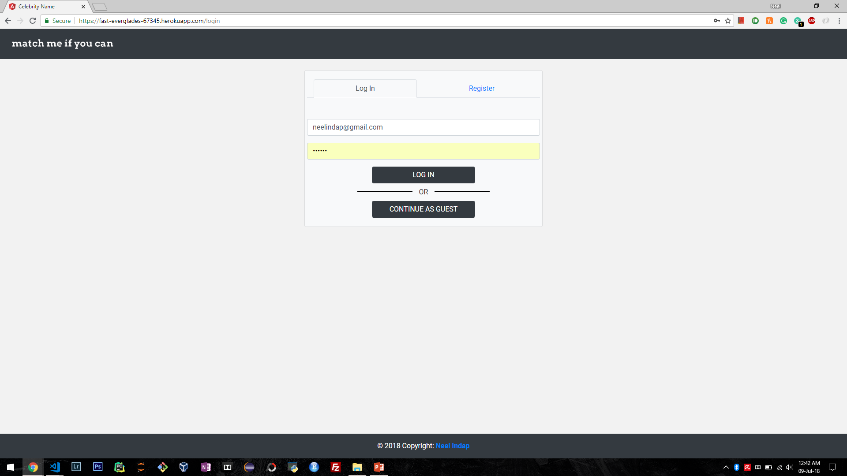

Slide 10
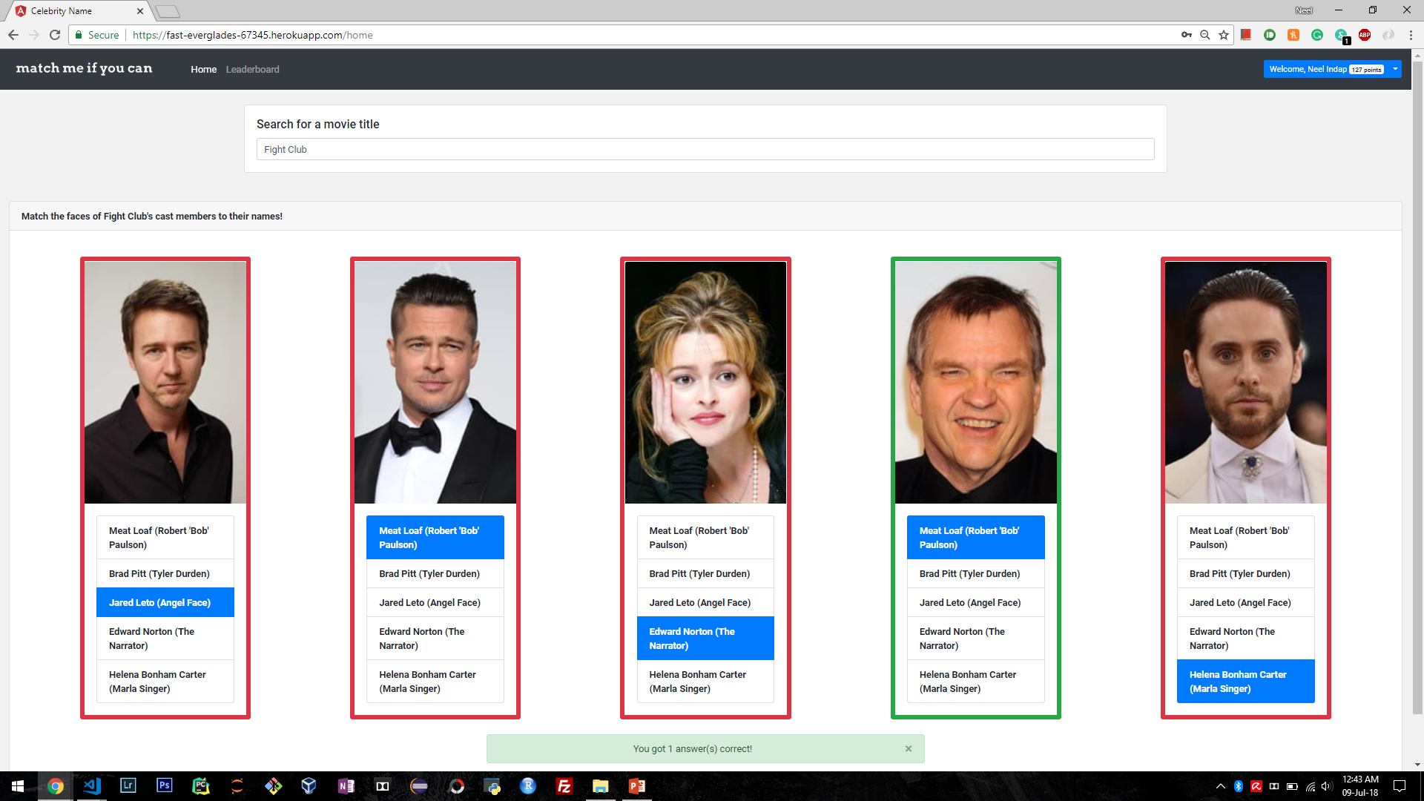

Slide 11
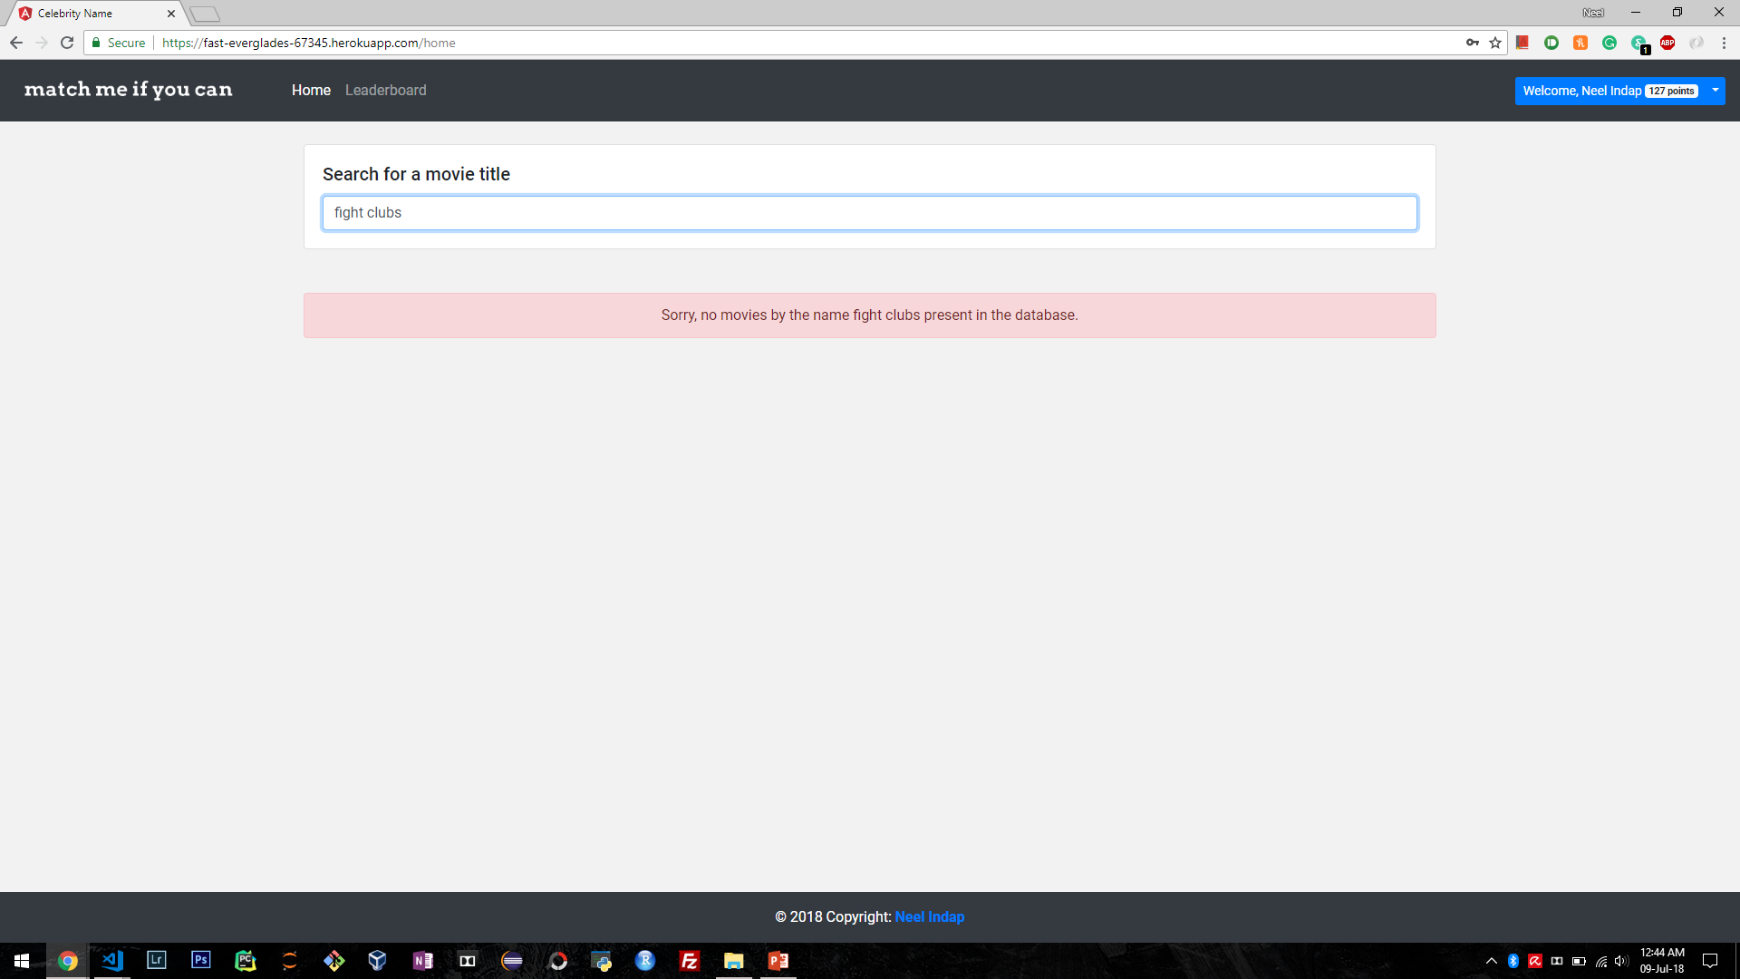

Slide 12
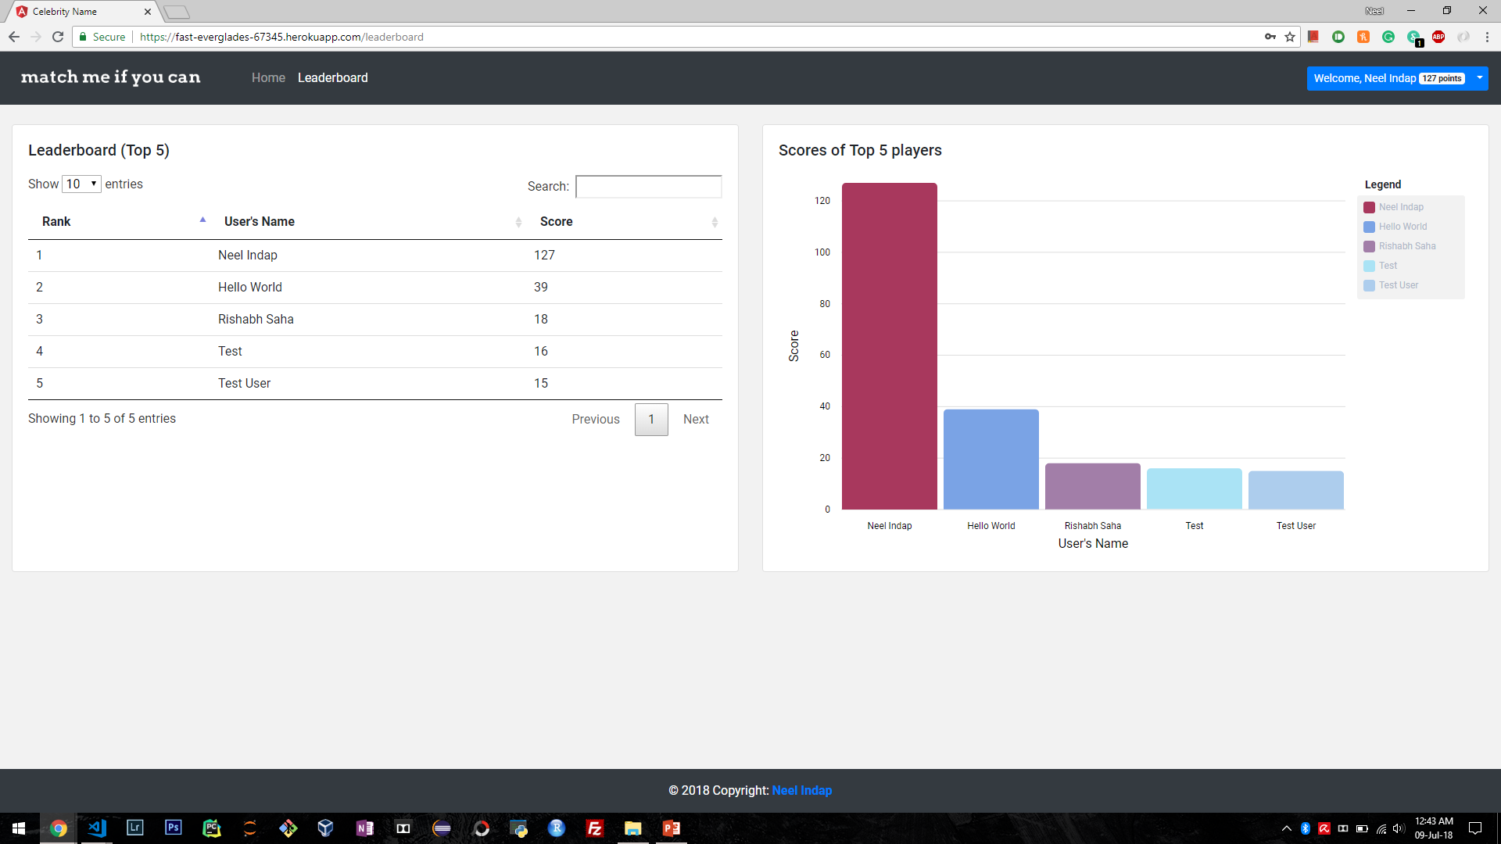

Slide 13
Future Scope
Use movie search data to promote movie renting
Caching of API results
Unit test cases for better code coverage
Cordova integration to convert web application to mobile application
Movie/cast trivia
Level badges
Competitions

Slide 14
Thank you
Enjoy the game at https://fast-everglades-67345.herokuapp.com/
References:
https://medium.com/@mcasciato/no-imdb-api-check-out-these-options-75917d0fe923
https://stackoverflow.com/questions/9560426/what-database-do-online-games-like-farmville-use
https://angular.io/docs
https://angularfirebase.com/

